Slide 1
Thinking Through Identification in a New Setting

Slide 2
We’ve learned the main identification strategies
This might give you the impression that all identification strategies neatly fit into one of several boxes (RCT, RD, DD, Matching, Synthetic Control)
That’s kind of right, but often there are important variations
Today we’re going to think through one of them

Slide 3
Variation
Many policies don’t turn on discretely when the value of a index changes.
Often, the amount of a payout increases at a certain point
For example: the Earned Income Tax Credit
This is a tax credit for low to middle income families (with children (mostly)).

Slide 4
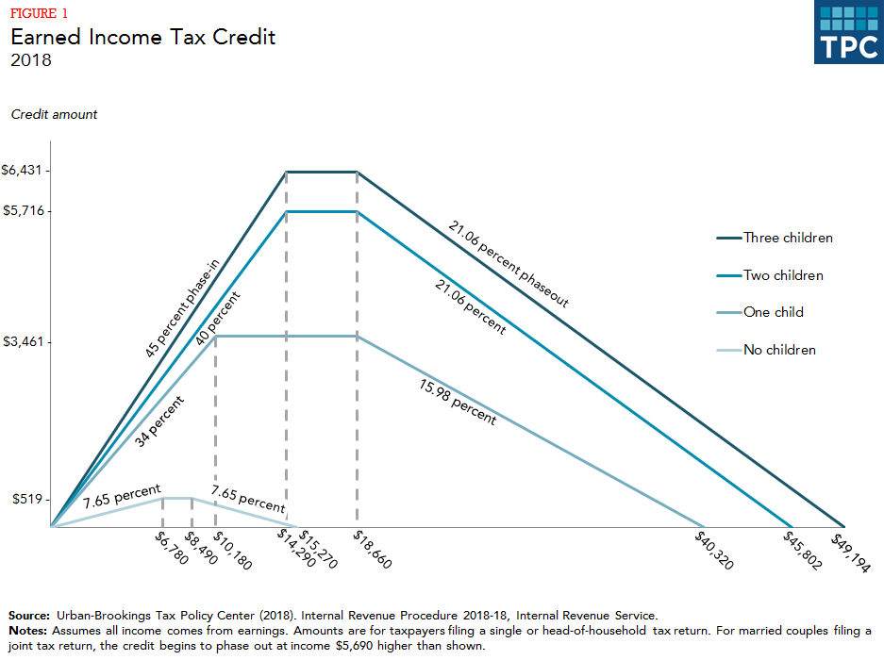
EITC Schedule

Slide 5
Variation
The EITC is kinked
Is this suitable for an RD?
Can we still identify something causal?
(yes)

Slide 6
Group Exercise
In a group talk about how you might do this
Answer the following questions:
What is the counterfactual?
What is the identifying assumption?
What is estimating equation
Hint: draw a picture

Slide 7
Cash-on-Hand and College Enrollment: Evidence from Population Tax Data and the Earned Income Tax Credit
Day Manoli and Nicholas Turner
American Economic Journal: Economic Policy 2018

Slide 8
Question
How does having more money affect going to college?
They use the EITC to answer this
They look at high school seniors and see if a bigger EITC changes the probability of going to college

Slide 9
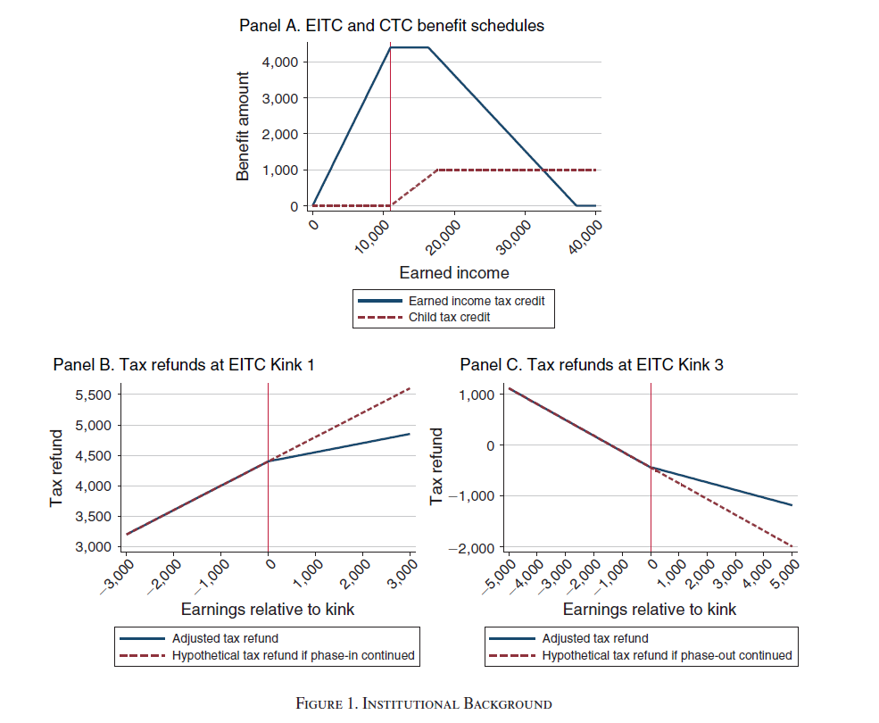
Policy Variation

Slide 10
Data
US Tax Return Data
17 to 18 years old during 2001-2011
Has data on family income and college enrollment from tax returns

Slide 11
Regression Kink
The basic idea is similar to an RD.
However an RD says that the relationship between the running variable and the outcome is smooth absent treatment
In an RK, the assumption is that the derivative of the relationship between the running variable and the outcome is smooth

Slide 12
In other words
There is a slope change that occurs due to policy
Is there a slope change in the outcome?

Slide 13
Cautions
You need a *ton* of data to have this estimated precisely
You still have to have similar assumptions that you do in RD but even stronger

Slide 14
Things to Check
Do people bunch at the kink point?
Does the slope of the covariates change at the kink point?
Does something else change at the kink point?

Slide 15
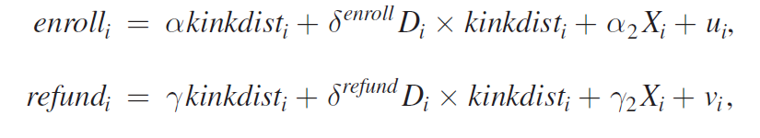
Equation

Slide 16
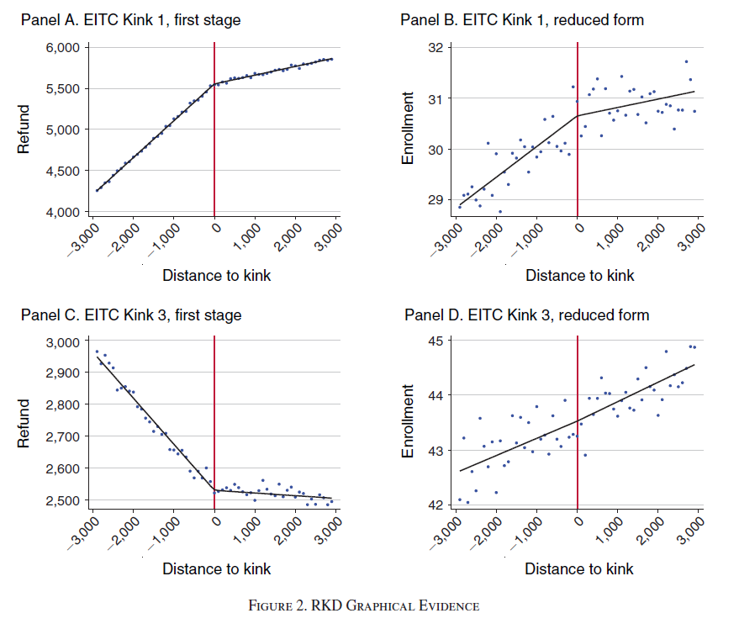
First Stage and Reduced Form

Slide 17
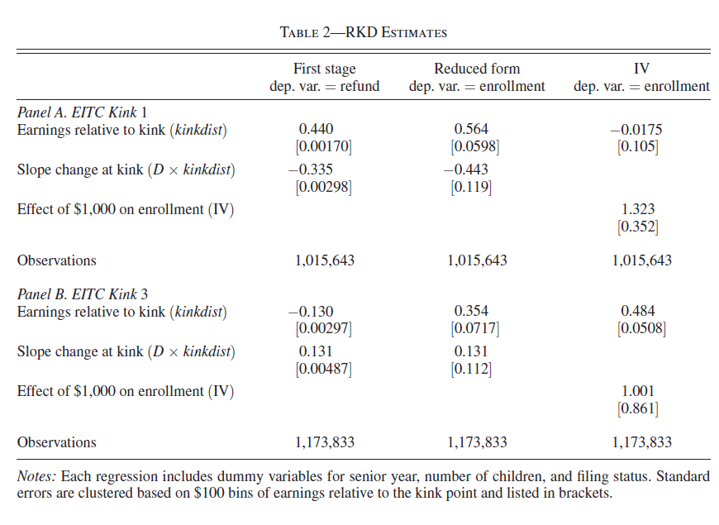
Estimates

Slide 18
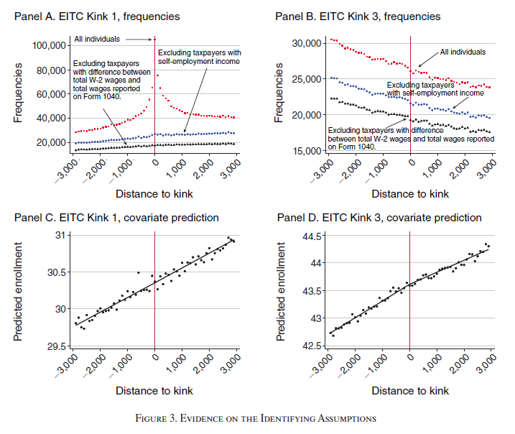
Assumptions

Slide 19
Conclusion
RK is a cousin of RD
Hopefully this exercise helped you think through how you can approach new problems
Money matters for college (for poor kids)

Slide 20
Bunching!

Slide 21
What if the running variable is manipulable?
A specific example
There is a change in the tax rate at a certain point. To change your taxes you can adjust your taxable income

Slide 22
What would it look like if people responded to this change?
What would it mean?

Slide 23
Bunching
This intuition has been used to estimate the elasticity of reported income to taxes
How?

Slide 24
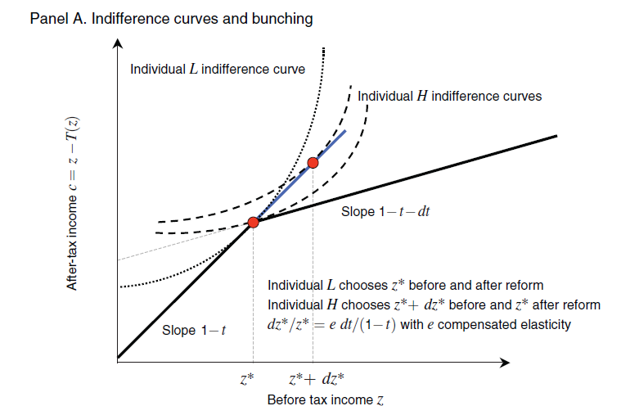
What economic process leads to bunching
This shows an indifference curve of a taxfiler who changes their income in response to the kink
Source: Saez, E. (2010). Do taxpayers bunch at kink points?. American economic Journal: economic policy, 2(3), 180-212.

Slide 25
Figure using uniform distribution
The distance the last buncher travels tells you how much they would change their income in response to the tax rate
This can be turned into an elasticity (change in pre tax income to change in post tax income)

Slide 26
Issues
What if people can’t pick their income precisely?
What if there is heterogeneity in the responsiveness to taxes?
How do you estimate the underlying distribution?

